Slide 1
Computational Intelligence
Machine Learning For Speaker Identification
Submitted by :
DIAB ELMEHDI (1324316)
Examiner : Prof. Dr. Andreas Pech
Presented : 09.07.2020
1

Slide 2





Introduction
Plan
Speaker Identification Architecture
Machine Learning for SI
Experimental result and analysis
Conclusion & Reference

Slide 3
Introduction
Part 1
General Topic
Machine Learning.

Slide 4
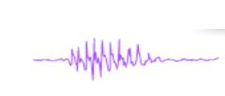
Introduction
Speaker Identification Architecture
ML For speaker Identification
Experimental Analysis and Result
Conclusion & Reference
General Topic
Machine Learning
Speaker Identification uses speech to identify a speaker based on its sound representations by matching the speaker 's voice profile with current profiles of specific speakers stored in the training Model.
Machine learning has been widely adopted in speech recognition and speaker identification task over traditional approaches such as those that use Mel-Frequency cepstral coefficients (MFCC) for feature extraction. to model a speaker voice based on the speaker acoustic characteristics we use GMM, SVM also HMM
Person N1
Person N2
Person N3
Whose voice is this ?
Person N4

Slide 5
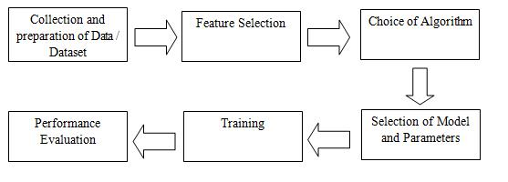
Introduction
Speaker Identification Architecture
ML For speaker Identification
Experimental Analysis and Result
Conclusion & Reference
General Topic
Machine Learning
Components of a Generic ML model
machine learning paradigms can be classified into fours categories
Supervised Learning
Unsupervised Learning
Semi Supervised Learning
Reinforcement

Slide 6
Speaker Identification Architecture
PART 2
Classification of SI
Phases of SI

Slide 7
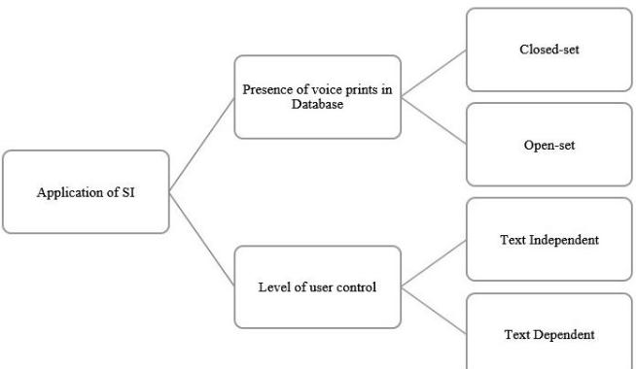
Introduction
Speaker Identification Architecture
ML For speaker Identification
Experimental Analysis and Result
Conclusion & Reference
Classification of SI
Phases of SI

Slide 8
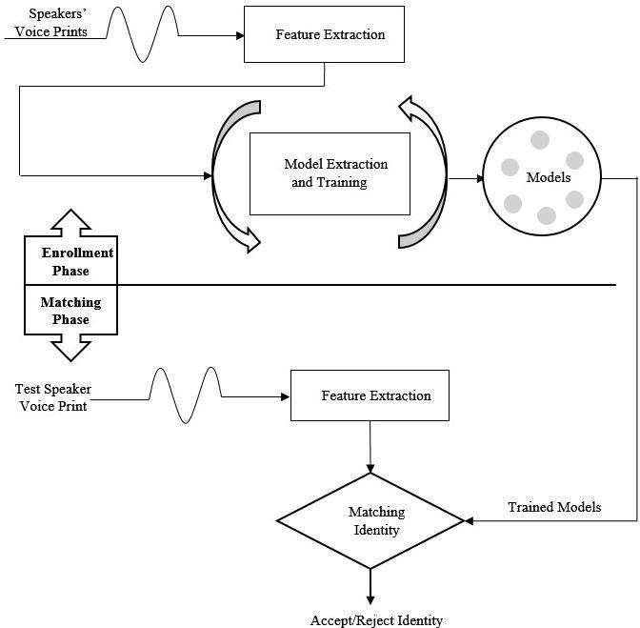
Introduction
Speaker Identification Architecture
ML For speaker Identification
Experimental Analysis and Result
Conclusion & Reference
Classification of SI
Phases of SI

Slide 9
ML for Speaker Identification
Part 3
Feature Extraction
Feature Matching and Modeling

Slide 10
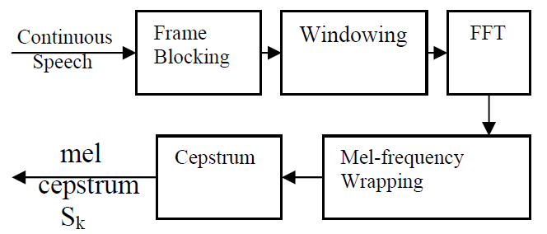

Introduction
Speaker Identification Architecture
ML For speaker Identification
Experimental Analysis and Result
Conclusion & Reference
Feature Extraction
Feature Matching and Modeling
Fast Fourier translates each sample N numbers from time domain to frequency domain. There are 512, 1024, 2048 FFT sizes. It is used to get frequency response in magnitude.
The window result is shown as
Y(n) = X(n) x w(n).
Where, Y(n) – output signal
X(n) – input signal
w(n) – hamming window
The MFCCs may be calculated using the following equation [15] [17 ]:
We can then measure the melts for a given frequency f in Hz using the following formula:
mel(f)= 2595*log10(1+f/700) ……….. (1)

Slide 11



Introduction
Speaker Identification Architecture
ML For speaker Identification
Experimental Analysis and Result
Conclusion & Reference
Feature Extraction
Feature Matching and Modeling
Gaussian Mixture Model (GMM)
The GMM forms the basis for both the training and classification processes. GMM-based classifiers have shown good performance in many applications including speech processing [9].
Feature Extraction.
posterior probability:
new estimates of ith weight:
new estimates of diagonal elements of ith covariance matrix:

Slide 12


Introduction
Speaker Identification Architecture
ML For speaker Identification
Experimental Analysis and Result
Conclusion & Reference
Feature Extraction
Feature Matching and Modeling
Classification
In this stage, a series of input vectors are compared, and a decision is made as to which of the speakers in the set is the most likely to have spoken the test data. The input to the classification system is denoted as : X = {x1, x2, x3, . . . , xT}
The rule to determine if X has come from speaker s can be stated as : p (λs | X) > p (λr | X) r = 1, 2, . . . , S (r ≠ s).
The likelihood of any speaker having spoken the test data is then referred to as the log likelihood and is represented by the symbol L. The formula for the loglikelihood Function is. [9]
The speaker of the test data is statistically chosen by
Speaker =

Slide 13
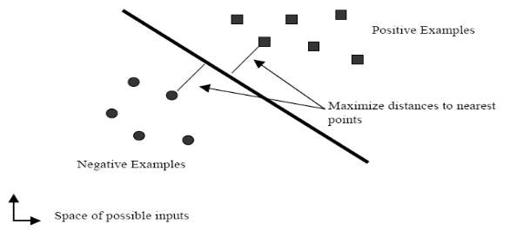

Introduction
Speaker Identification Architecture
ML For speaker Identification
Experimental Analysis and Result
Conclusion & Reference
Feature Extraction
Feature Matching and Modeling
Support vector Machine (SVM)
Is a Kernel Machine method that makes its decision by constructing a hyperplane that optimally separates 2 classes .
The classifier is a separating hyperplane that satisfy this equation (xs ⋅ w0 + b)ys = 1.
Most important training Point are support vectors they define the hyperplane
Quadratic Optimization (QO) algorithms can identify which training point xi are support vectors with non zero Lagrangian Multipliers
For not linearly separable data, no hyperplane exists for which all points that satisfy the inequality above. To overcome this problem, ζ _{i} are introduced and the object is then achieved by minimizing
A linear support vector machine

Slide 14
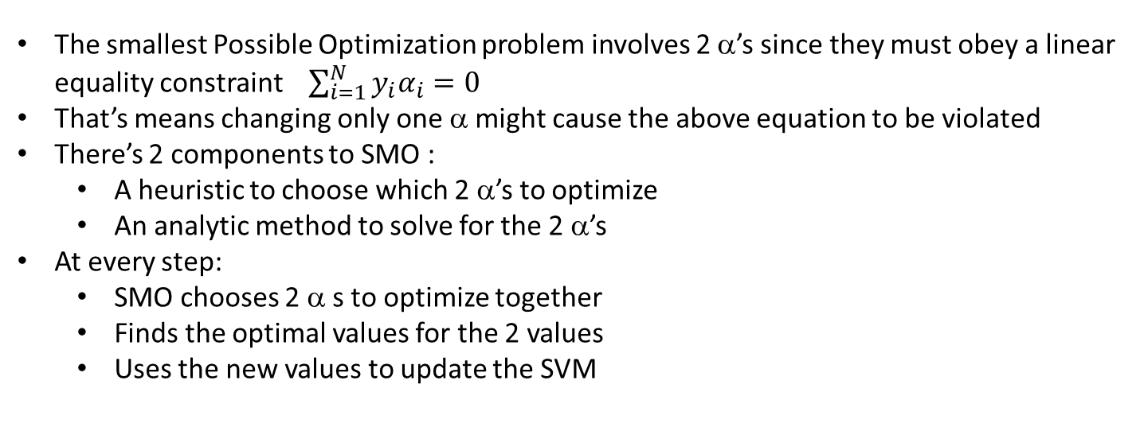
Introduction
Speaker Identification Architecture
ML For speaker Identification
Experimental Analysis and Result
Conclusion & Reference
Feature Extraction
Feature Matching and Modeling
Sequential minimal optimization (SMO)
Sequential minimal optimization (SMO) is a simple algorithm that can quickly solve the SVM problem without any extra matrix storage and without using numerical quadratic optimization steps at all.
For speaker Identification , the first approach in using SVM classifiers was implemented by Schmidt in [22]. Another approach became recently more popular, consists of using a SMO as solution .
The smallest Possible Optimization problem involves 2 α’s since they must obey a linear equality constraint $\sum_{i=1}^{N}{y_{i}α_{i}}=0$
That’s means changing only one α might cause the above equation to be violated
There’s 2 components to SMO :
A heuristic to choose which 2 α’s to optimize
An analytic method to solve for the 2 α’s
At every step:
SMO chooses 2 α s to optimize together
Finds the optimal values for the 2 values
Uses the new values to update the SVM

Slide 15
Introduction
Speaker Identification Architecture
ML For speaker Identification
Experimental Analysis and Result
Conclusion & Reference
Feature Extraction
Feature Matching and Modeling
Hidden Markov Model (HMM)
There are three centrals HMM problems in finding the probability of speech feature vectors generated from an HMM :
The standard or reference solution and the sub-band-based marker use HMM recognizers. The left-to-right or bark models are the HMM type that is used. This pattern is primarily used to understand voice or speaker.
Evaluation Problem
Hidden State Determination (Decoding)
Learning
Notes:
The probability of HMM speech feature vectors is determined with the probability of change between states and the probability of the occurrence of feature vectors in a certain environment . s

Slide 16
Experimental Analysis and Result
Part 4
Data set and Feature Used GMM

Slide 17

Introduction
Speaker Identification Architecture
ML For speaker Identification
Experimental Analysis and Result
Conclusion & Reference
Data set and Feature Used GMM
We performed experiments on the 2002 and 2003 NIST speaker recognition (SRE) corpora [27, 28].
We have seen 122 male around three minutes of speech time in the training period.
The 2003 NIST SRE corpus research results are 30’s each of the check utterance.
After Elimination of pause section of the voice we break each utterance into fragment of roughly 5’s of training and Experiment
The result in total of 3617 teaching Example with 30 Examples per Speaker Class just 3044 Example are listed
For function extraction:
For a speech signals a frame size of 20 ms is used and a change of 10 ms frame is seen using a 39 dimensional Vector with 12 MFCC log energy and delta and their Accelerating Coefficients.
Th e Accuracy of the classification gives the percentage of test Examples properly Classified by the Classification System.
Model | Number of components (Q) | Classification accuracy (in %)
GMM | 32 64 128 | 75.81±1.52 76.50±1.51 71.26±1.61
Adapted GMM | 1.024 | 83.08±1.33
Comparison of classification accuracy (in %), estimated at 95% confidence intervals, given by the GMM-based system and the adapted GMM-based system for speaker identification task [36]
The reliability intervals of classification accuracy are estimated at 95 percent. Classification accuracy confidence interval (CI) is measured as :

Slide 18
Conclusion & Reference
Part 5

Slide 19
Introduction
Speaker Identification Architecture
ML For speaker Identification
Experimental Analysis and Result
Conclusion & Reference
How ML Can be used for SI through a different Algorithm such As:
Feature Extraction (MFCC)
GMM & SVM Approaches to recognize the speaker
The distressing preparation has a great deal to say The GMM parameter estimation method is expected to improve performance Method with optimum likelihood.
Creation of SVM classifiers for biased training to construct the correct dynamic kernel for SI different patterns of length represented by feature vector sets

Slide 20
Introduction
Speaker Identification Architecture
ML For speaker Identification
Experimental Analysis and Result
Conclusion & Reference
[1] | J. Campbell Jr., Speaker recognition: a tutorial. Proc, IEEE 85(9),, 1437–1462 (1997).
[2] | F. e. a. Bimbot, A tutorial on text-independent speaker verification, EURASIP J. Appl.Signal Process. 1, 430–451 (2004).
[3] | D. Q. T. D. R. Reynolds, Speaker verification using adapted gaussian, ISSN 1051–2004, 10(1–3), 19–41 (2000).
[4] | S. Safavi, Speaker characterization using adult and children’s speech. Ph. D. dissertation,, 2015.
[5] | S. G. H. M. I. S. R. Safavi, Fraud detection in voice-based identity authentication applications and services, In: Proceedings of ICDM, 2016.
[6] | A. L. K. M. B. L. H. Larcher, Text-dependent speaker verification: classifiers,, ISSN 0167–6393, 60, 56–77 (2014),.
[7] | S. M. P. Davis, Comparison of parametric representations for monosyllabic word recognition in continuously spoken sentences., 28(4), 357–366 (1980): IEEE Trans. Acoust. Speech Signal Process.
[8] | S. Furui, Cepstral analysis technique for automatic speaker verification., Speech Signal Process éd., (1981): IEEE Trans..
[9] | D. R. R. Reynolds, Robust text-independent speaker identification using Gaussian mixture speaker models, Speech Audio Process éd., IEEE Trans, (1995).
[10] | W. S. D. R. D. Campbell, Support vector machines using GMM supervectors for speaker verification, IEEE Signal Process, (2006).
[11] | D. Reynolds, An overview of automatic speaker recognition In Proceedings of the International Conference on Acoustics, (ICASSP), 2002.
[12] | A. A. a. M. D. H. Kekre, Speaker identification using row mean vector of spectrogram. In Proceedings of the International Conference & Workshop on Emerging Trends in Technology, 2011, p. pages 171–174. ACM.
[13] | G. K. Verma, Multi-feature fusion for closed set text independent speaker identification, In International Conference on Information Intelligence, Systems, Technology and Management, Springer, 2011, p. pages 170–179..
[14] | L. R. a. B.-H. Juang, Fundamental of Speech Recognition, Prentice-Hall,, 1993.
[15] | E. R. B. J. a. L. R. A. V. F. Soong, «Quantization Approach to Speaker Recognition,» AT&T Technical Journal, pp. vol. 66,pp.14-26, March/April 1987..
[16] | C. Frequently, «Asked Questions,» [En ligne]. Available: http://svr-www.eng.cam.ac.uk/comp.speech.
[17] | J. D. H. J. a. P. J. Jr., «Discrete-Time Processing of Speech Signals,» IEEE Press,New York, n° %1second ed., 2000.
[18] | C. J. C. A. Burges, «Tutorial on Support Vector Machines for Pattern Recognition, submitted to Data Mining and Knowledge Discovery,,» 1998. [En ligne]. Available: http://svm.research.bell-labs.com/SVMdoc.html,.
[19] | R. Auckenthaler, "Test-independent speaker identification with limited resources,," University ofWales, 2001.
[20] | . N. Holmes and W. J. Holmes, Speech Synthesis and Recognition,, 2nd edition, éd., London,: Taylor & Francis, 2002.
[21] | S. Haykin, Neural Networks a Comprehensive Foundation,, Hamilton, Ontario, , McMaster University.
[22] | [En ligne]. Available: ftp://ftp.ics.uci.edu/pub/machine-learningdatabases/.
[23] | V. Vapnik, «Estimation of Dependences Based on Empirical Data,,» Springer-Verlag,1982.
[24] | E. F. R. G. F. Osuna, «Improved Training Algorithm for Support Vector Machines,» NNSP ’97, 1997.
[25] | L. R. Rabiner, “A Tutorial On Hidden Markov Models And Selected Applications In Speech Recognition”, vol. 77(2), Proceedings of the IEEE, 1989.
[26] | «The NIST,» speaker recognition evaluation plan, 2002. [En ligne]. Available: http://www.itl.nist.gov/iad/mig/.
[27] | «THE NIST,» speaker recognition evaluation plan., 2003. [En ligne]. Available: http://www.itl.nist.gov/iad/mig/.
[28] | L. C.-J. Chang C-C, «LIBSVM: a library for support vector machines. Software available,» 2001. [En ligne]. Available: http://www.csie.ntu.edu.tw/cjlin/libsvm.
[29] | Q. T. D. R. Reynolds DA, «Speaker verification using adapted Gaussian mixture models.,» p. Digit Signal Process 10:19–41, 2000.
[30] | N. RG, Two-sided confidence intervals for the single proportion: comparison of seven methods, 1998.
[31] | C. K. R. Sandhya N. dhage, «“A review on Machine Learning Techniques”,» vol. Volume 4 Issue 3, pp. ISSN: 2321-8169, PP: 395 – 399, March 16.
[32] | AyonDey, «Machine Learning Algorithms: A Review”».
[33] | A. r. b. R. Society, «“Machine learning: the power and promise of computers that learn by example “,» vol. Vol. 7 (3), April 2017.
[34] | Y. P. M. S. K. G. T. K. Al-Jarrah OY, «Efficient machine learning for big data : A review. Big Data Res.,» vol. 2(3):87–93., 2015.
[35] | Z. X, «Semi-supervised learning literature survey,» University of Wisconsin-Madison, 2006.
[36] | P. C. C. S. M. Tech. A. D. Dileep, Forensic Speaker Recognition, New York: Springer New York.

